Slide 2
Part 1
Network Basics and OSI Review

Slide 3
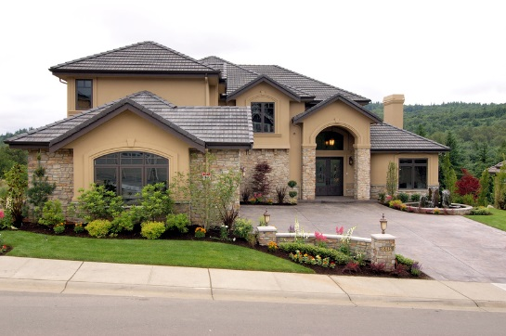

Mobile User
Home Office
Internet/WAN
Main Office
Branch Office

Slide 4
Physical Network Components
End Points: Computers, Mobile Devices, etc
Interconnections: NIC’s, Media, Connectors
Switches: Layer 2 addressing/LAN’s
Routers: Layer 3 addressing/internets

Slide 5
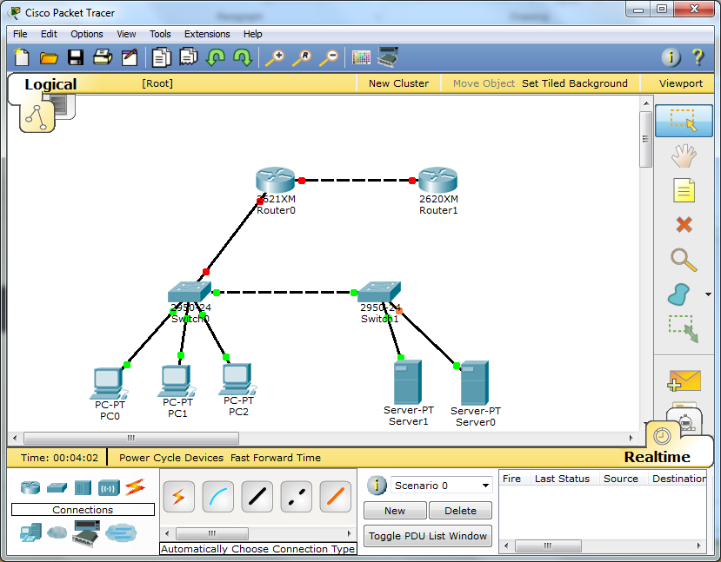

Slide 6
Topologies
Bus: all end devices share one line
Star: all end devices connect to a central intermediary device, but have their own lines (modern switch)
Ring: all end devices connect to each other in sequence
Mesh: all end devices have multiple connection lines to one another
Partial Mesh: there are some multiple connection lines between end devices

Slide 7
Star
Bus
Ring
Full-Mesh
Partial-Mesh

Slide 8

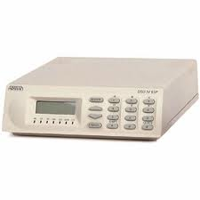
General Concepts
LAN
Local Loop
LAN
Router
Switch
Switch
Router
WAN
CPE
Demarcation Line
Web Server
Work Stations

Slide 9
OSI Model
OSI Layer | Functionality
7. Application | Specifies ways for applications to use a network: HTTP, SMTP, FTP, etc
6. Presentation | Specifies data format/coding standards so that applications can communicate, encryption is also handled at this level
5. Session | Specifies session rules for applications including class of service rules
4. Transport | Specifies end-to-end data transmission functions such as data segmentation and error correction; not concerned with application issues, only data-across the-network issues
3. Network | Specifies connectivity and path selection between host over remote (non-LAN) networks or internets
2. Data Link | Specifies how data is switched around LAN’s or WAN links using MAC addresses
1. Physical | Specifies hardware dimensions for network equipment

Slide 10
Encapsulation
Each layer has a unit that performs the functions of the layer
Each layer wraps or encapsulates the unit from the layer above or de-encapsulates it from the layer below.
These units are generically termed “messages” which can be confusing since applications ultimately are exchanging data in the form of a message.
Cisco uses the term “Protocol Data Unit” or PDU for network layer units

Slide 11
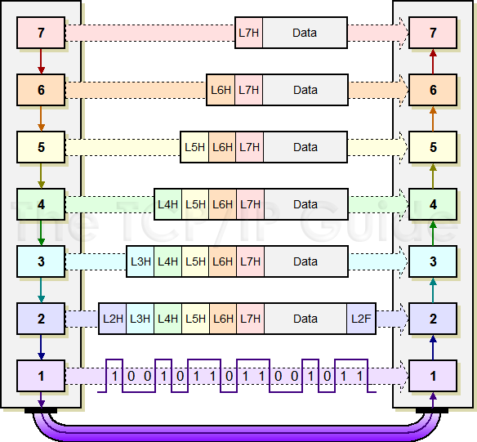

Slide 12
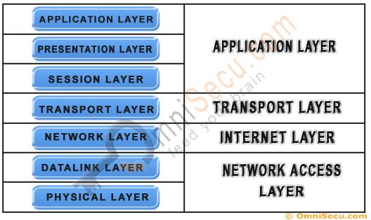
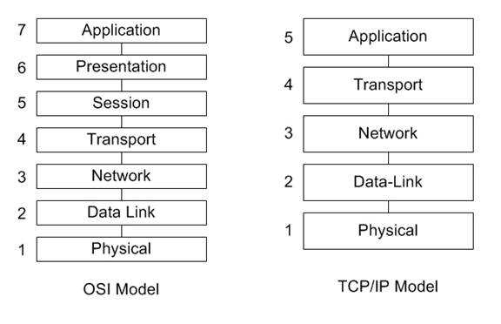
OSI 7-Layer and TCP/IP Standard
OSI 7-Layer and Modified TCP/IP

Slide 14
Chapter 2
LAN’s and Ethernet

Slide 15
LAN Definition/Characteristics
Connects a few or many computers within a local geographical or physical area
No telecom provider used to connect computer within the LAN, but a Telecom provider is used to connect the entire LAN to the Internet via a dedicated gateway router(s)
Like any network, LAN’s facilitate sharing data, applications, hardware and communications

Slide 16
Physical LAN Components
End Points: Computers, Mobile Devices, etc
Interconnections: NIC’s, Media, Connectors
Switches: Layer 2 addressing/LAN’s
Routers: Layer 3 addressing/internets – within a LAN context, routers facilitate VLAN’s and subnets

Slide 17



Switch Levels (Cisco)
Core
Distribution
Access

Slide 18
Ethernet History
Developed by Robert Metcalf at Xerox in the early 70’s
Originally used coaxial cable and a bus topology
Original speed was 10 Mb/sec
Modern Ethernet uses UTP and Fiber
Current speeds range from 100 Mb/sec to 100 Gb/sec
100 Mb/sec uses Cat 5e or Cat 6 UTP
Workstation LANs
1Gb/sec uses Cat 5e, Cat 6 UTP or fiber optic
Workstation LANs and trunk lines
10 Gb/sec (also Cat 6 or 7), 40 Gb/sec and 100 Gb/sec use fiber optic
Server farms and trunk lines

Slide 19
Where does Ethernet fit Into OSI Model?
Ethernet is concentrated in the data link layer or layer 2 of the OSI model.
Ethernet also has specs that “reach” into the physical layer or layer 1of the OSI model.
Ethernet standard is governed by the ISO but the actual work standards are developed under the IEEE 802.3 Working Group.

Slide 20
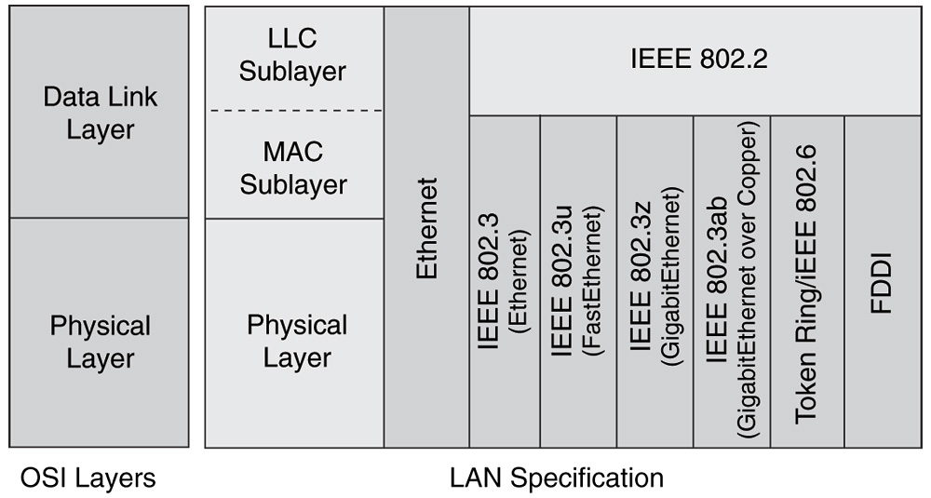

Slide 21
Internet Layer |  | TCP/IP Internet Layer Standards (IP, ARP, etc.) |  | Other Internet Layer Standards (IPX, etc.)
Data Link Layer | Logical Link Control Layer | 802.2
 | Media Access Control Layer | Ethernet 802.3 MAC Layer Standard |  |  |  | Non-Ethernet MAC Standards (802.11, 802.16, etc.)
Physical Layer |  | 100BASE-TX | 1000BASE-SX |  | … | …
MAC Addresses/ Ethernet Frame Structure

Slide 22


6.4: Ethernet Physical Layer Standards
Physical Standard | Speed | Max. Run Length | Medium
4-Pair UTP
100BASE-TX | 100 Mbps | 100 m | Category 5e or higher
1000BASE-T | 1 Gbps | 100 m | Category 5e or higher
10GBASE-T | 10 Gbps | 55 m | Category 6
10GBASE-T | 10 Gbps | 100 m | Category 6a or Category 7

Slide 23
6.4: Ethernet Physical Layer Standards
Physical Standard | Speed | Max. Run Length | Core (microns) | Modal Bandwidth
Optical fiber (850 nm)
1000BASE-SX | 1 Gbps | 220m | 62.5 | 160 MHz*km
1000BASE-SX | 1 Gbps | 275 m | 62.5 | 160 MHz*km
1000BASE-SX | 1 Gbps | 500 m | 50 | 160 MHz*km
1000BASE-LX | 1 Gbps | 5000 m (single mode) 550 m (multi-mode) | 8.3/50 | 160 MHz*km

Slide 24
6.9: Ethernet MAC Layer Frame
Ethernet Frame Structure – Data Link Layer
Preamble (7 octets of 10101010 for synchronization
Start Frame Delimiter (10101011 to end synch)
Destination MAC address (48 bits) (destination host)
Source MAC address (48 bits) (source host)
Tag Protocol ID (TPID, Optional, 2 octets) (VLANs)
Tag Control Information (TCI, optional, 2 octets) (VLANs)
Length (2 octets) (length of data field)
Logical Link Control (LLC subheader, 8 octets) (Packet type)
Packet (variable length) (usually an IP packet)
PAD (Situation-Specific) (“fill” data field)
Frame Check Sequence (for error checking)

Slide 25
Ethernet MAC Addresses
48-bit number expressed in Hexadecimal Form
Bit 1 for broadcast, Bit 2 for local setting
Bits 3-24 are the Organizational Unique Identifier (OUI)
Bits 25-48 are the vendor-assigned end station address
1
1
22-bits
24-bits
B
L
OUI
Vendor Assigned

Slide 26
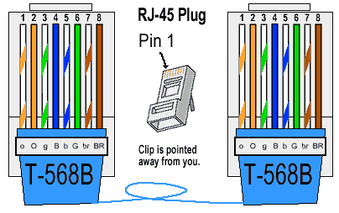
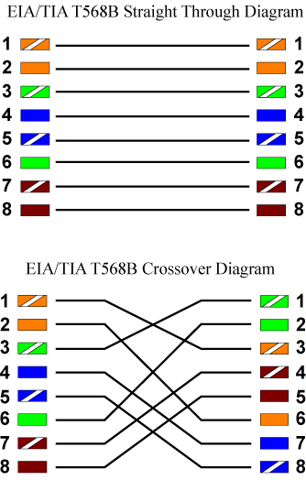
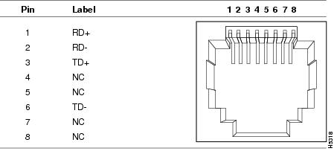

Slide 27
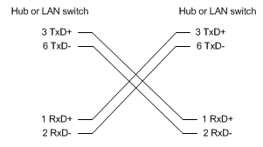
Cross-over Cable Wiring Diagram

Slide 28
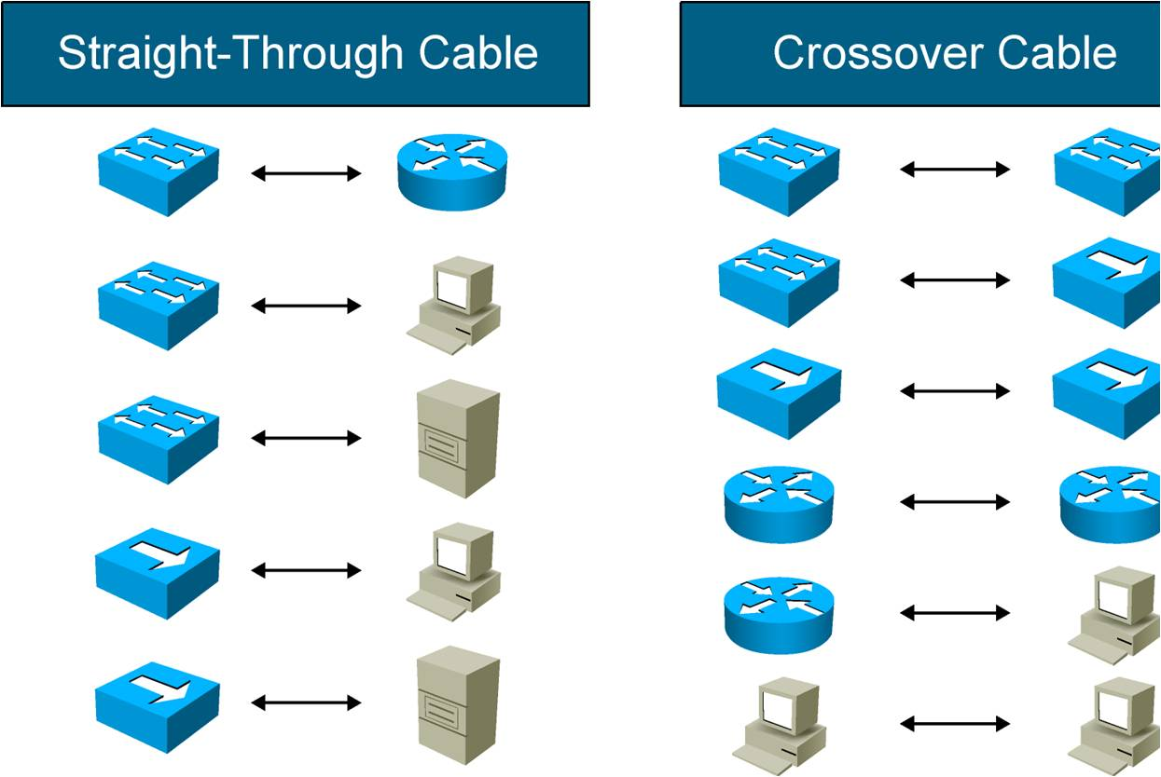
Like devices use cross-over, unlike devices use straight-through
Auto-MDIX or automatic medium-dependent interface crossover can accommodate any wiring configuration

Slide 29
Fiber Optics
Fiber-optic cables can be used instead of UTP.
More expensive than copper UTP
Higher bandwidth and longer distance signal propagation
Usually used in the core portions of LAN’s

Slide 30
Fiber Characteristics
Multi-mode Fiber MMF | Single-mode Fiber SMF
LED transmitter | LED or Laser
Lower Bandwidth | Higher Bandwidth
Shorter Distances | Longer Distances
Less Expensive | More Expensive
LAN’s | Trunks/Core

Slide 31
Some Current Standards
Name | Mode | Wavelength | Distance | Core size
100Base FX | Multimode | 1350 nm | 412 meters | 50 or 62.5 microns
100Base SX | Multimode | 850 nm | 550 meters | 50 microns
100Base LX | Singlemode | 1310/1550 nm | 10 kilometers | 8.3 microns (dual strand)
1000Base SX | Multimode | 770 – 860 nm | 220-550 meters | 50 or 62.5 microns
1000Base LX | Singlemode | 1270 - 1355 | 5 kilometers | 10 microns
1000Base LX | Multimode | 1270 - 1355 | 300-550 meters | 50 microns

Slide 32
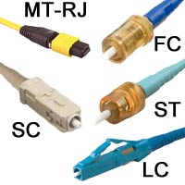
ST: patch panels
FC: patch panels
SC: enterprise hardware
LC: newer, smaller for enterprise hardware

Slide 33
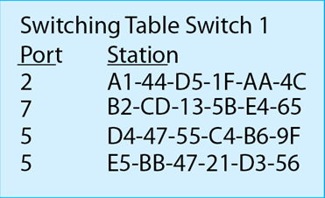
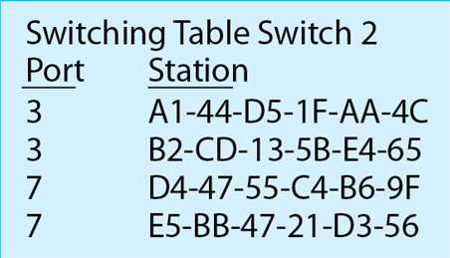
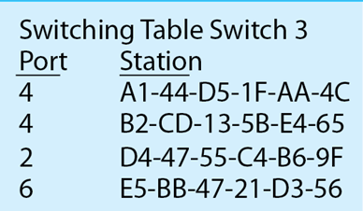
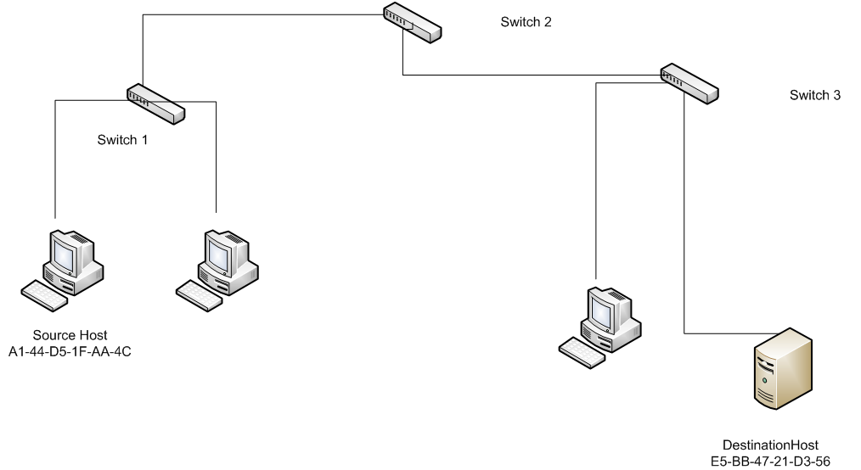
Ports travelled:
Switch 1, Port 5
Switch 2, Port 7
Switch 3, Port 6

Slide 35
Cisco IOS
Operating System
&
Command Line Interface, CLI

Slide 36
Cisco IOS
Originally Cisco Internetworking Operating System, now just IOS
Operating system for Cisco switches and routers.
Standard interface is the command-line interface or CLI which uses text-based commands.
A GUI interface exists: Cisco Web Browser UI, but Cisco requires CLI knowledge as the basis for configuring its devices

Slide 37
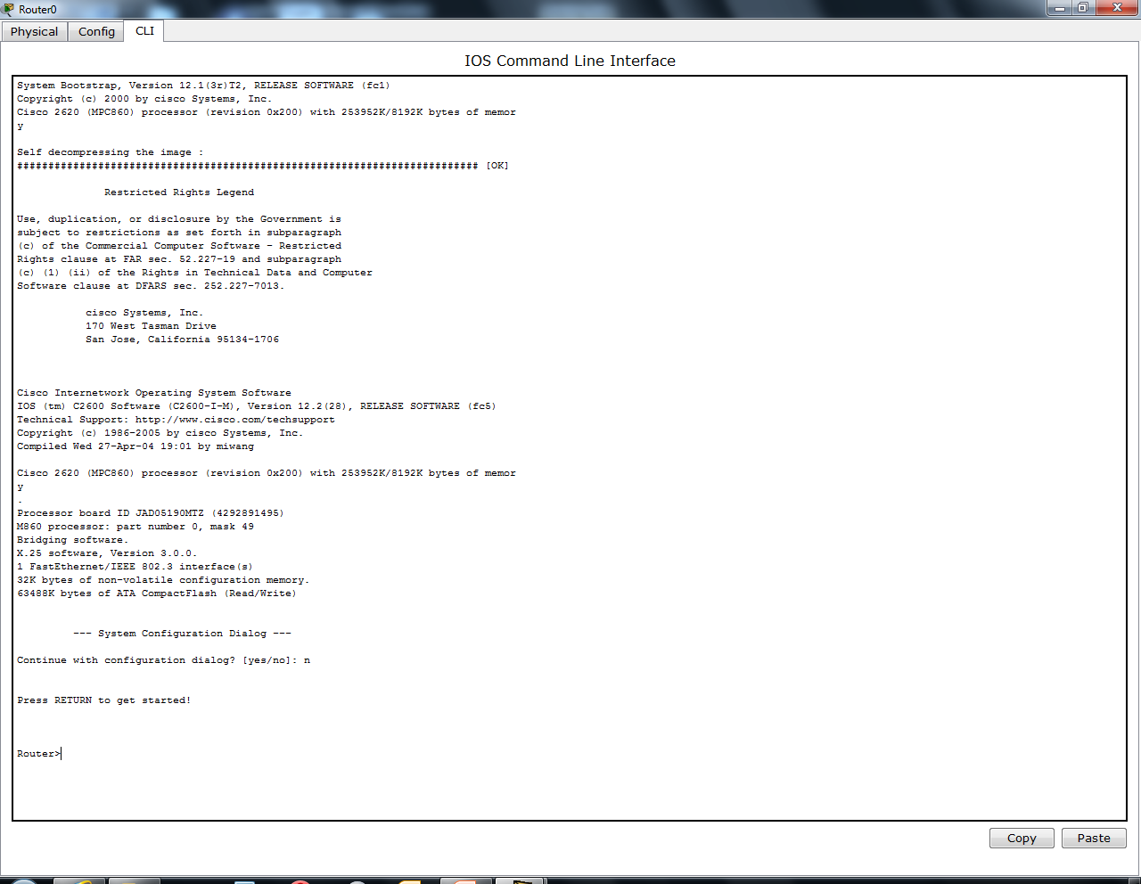
Console screen at router start-up

Slide 38
‘enable’ command to move to ‘privileged exec’
router>enable
router#
router#config t
Enter configuration commands, one per line. End with CNTL/Z.
router(config)#hostname testrouter
testrouter(config)#end
testrouter#
%SYS-5-CONFIG_I: Configured from console by console
exit
Prompt changes to indicate ‘privileged exec’ mode

Slide 39
testrouter>enable
testrouter#?
Exec commands:
<1-99> Session number to resume
auto Exec level Automation
clear Reset functions
clock Manage the system clock
configure Enter configuration mode
connect Open a terminal connection
copy Copy from one file to another
debug Debugging functions (see also 'undebug')
delete Delete a file
dir List files on a filesystem
disable Turn off privileged commands
disconnect Disconnect an existing network connection
enable Turn on privileged commands
erase Erase a filesystem
exit Exit from the EXEC
logout Exit from the EXEC
mkdir Create new directory
more Display the contents of a file
no Disable debugging informations
ping Send echo messages
reload Halt and perform a cold restart
resume Resume an active network connection
rmdir Remove existing directory
setup Run the SETUP command facility
show Show running system information
ssh Open a secure shell client connection
telnet Open a telnet connection
terminal Set terminal line parameters
traceroute Trace route to destination
undebug Disable debugging functions (see also 'debug')
write Write running configuration to memory, network, or terminal
testrouter#
Enter ‘?’ to find list of available commands

Slide 40
Other Commands
Configuration command to change device parameters
Configure terminal or config t (abbreviated)
Command History
Ctrl-p or up arrow key will display most recent commands
Ctrl-n or down arrow key will display more recent commands from command history

Slide 41
Cisco IOS Memory
RAM: stores routing tables and cache, IOS and the running configuration file
NVRAM: writable permanent storage for start-up configuration file
Flash: permanent storage of IOS (device off)
ROM: POST and boot code plus mini-IOS for trouble-shooting, emergencies and password recovery

Slide 42
Startup-configuration/Running-configuration files
Device configuration is stored in the startup configuration file. This file is copied into RAM during device boot to configure device settings.
The copy in RAM is the running-configuration file.
Changes made to the device configuration are made to the running-configuration file and must be saved to the startup-configuration file for the changes to remain on the next reload or reboot. This is done by saving the running-configuration file to the startup-configuration file which overwrites it.
Startup-configuration file can be stored on a TFTP server. Loading the startup or running configuration file from a TFTP server merges the files, not overwrites them.

Slide 43
Passwords
Passwords can be created for:
Line console – the ability for the use to get the CLI command prompt
Exec Privilege Mode – the ability to issue configuration commands
VTY – telnet access
Passwords are stored in the running and startup configuration files in plain text
Using the ‘enable secret’ command followed by the password will encrypt it.

Slide 44
Configuring Passwords
Switch>enable
Switch# configure terminal or config t
Switch(config)#enable secret(or password) execpass
Switch(config)# line console 0
Switch(config-line)#password linepass
Switch(config-line)#login
Switch(config-line)#exit
Switch(config)#line vty 0 15
Switch(config-line)#password vpass
Switch(config-line)#login
Switch(config-line)#exit
SSH is a secure version of telnet (vty) and should be used instead of vty. See the textbook for the discussion and commands

Slide 45
IPv4 Remote Access
Switches can be managed remotely by network management software if their vlan 1 is assigned an IPv4 address
Switch# config t
Switch(config)#interface vlan 1
Switch(config-if)#192.168.1.200 255.255.255.0
Switch(config-if)#not shutdown
Switch(config-if)#exit
Switch(config)#ip default-gateway 192.168.1.1 (router interface that leads out of LAN)
Or dynamically:
Switch# config t
Switch(config)#interface vlan 1
Switch(config-if)#192.168.1.200 255.255.255.0
Switch(config-if)#not shutdown
Switch(config-if)#exit

Slide 46
Other Commands
No logging console (stops echos on screen when commands are entered)
Logging synchronous (spaces out command echos)
No ip domain-lookup (stops IP lookups – done when misspelled command is entered)
Show run – displays running configuration file contents
Copy start run – copies running configuration file contents into the startup-configuration file
Debug command – never use!

Slide 48
Switch Address Tables
Chapter 5

Slide 49
Basics
A switch’s address table is also called:
Content Addressable Memory or CAM table (Cisco)
Switching table
Bridging table (old term)
MAC table (used in the following examples)
The switching table is stored in the switch’s RAM
A switch populates or learns the MAC addresses of each device that is connected to it by recording the source MAC address of a frame that it receives from each port.
The switch ages or erases the entire table every 5 minutes (Cisco default) and starts relearning MAC addresses. (Command to change refresh time: mac-address table-aging seconds – default is 600 seconds in Cisco switches)
If a switch receives a frame with a destination MAC address that is not listed in its switching table, it floods a copy of the frame out of every connected port (except the port from where the frame was received). Once it receives a reply frame from the device with that MAC address, it records the frame’s source MAC address and matches it to the port from which it received the frame.

Slide 50

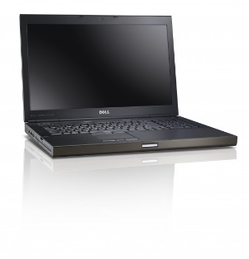
MAC Table:
2A: Fa0/2
S1
Fa0/1
Fa0/2
Fa0/3
S2
S3
Fa0/1
Fa0/1
MAC Table:
2A: Fa0/1
MAC Table:
2A: Fa0/4
Fa0/4
Fa0/6
Arp Frame:
Whois 4B?
Arp Frame:
Whois 4B?
MAC: 2A
MAC: 4B

Slide 51
Switch Reminders
Switches begin with no MAC address table entries.
When a switch receives a frame whose destination MAC address is not in its MAC table (as in the beginning state when switches have no MAC entries), it floods copies of the frame out of every active port except the port from which the frame entered the switch.
It records the source MAC address from the frame that it received in its MAC address table as associated with the switches’ port number.
Switching terms:
Flooding: sending a copy of a frame out each connected port except the port that it received the frame.
Filtering: not sending a frame out of the switch usually because the switch receives a frame whose destination MAC address is associated with the port the frame arrived from.
Forwarding: sending a frame out of a single port that is associated with the destination MAC address of a frame that it receives.

Slide 53
Port Security
Chapter 6, Volume 2

Slide 54
Port Security
Use port security when appropriate (most of the time)
static MAC address assignment to each port
Dynamic sticky MAC address assignment to each port
Dynamic MAC registered on each reload or restart

Slide 55
Port security
• Configure each port to accept
– One MAC address only
– A small group of MAC addresses
• Frames from other MAC addresses are not
forwarded.
• By default, the port will shut down if the wrong
device connects. It has to be brought up again
manually.

Slide 56
Static secure MAC address
• Limit access to one, manually configured MAC
address.
• Manually configured in interface config mode
• switchport port-security mac-address 000c.
7259.0a63 interface fa 0/4
• Stored in MAC address table
• In running configuration
• Can be saved with the rest of the configuration.

Slide 57
Dynamic secure MAC address
• Learned dynamically
• Default – learn one address.
• Put in MAC address table
• Not in running configuration
• Not saved, not there when switch restarts.
• SW1(config-if)#switchport mode access
• SW1(config-if)#switchport port-security

Slide 58
Sticky secure MAC address
• Dynamically learned
• Choose how many can be learned, default 1.
• Put in running configuration
• Saved if you save running configuration and
still there when switch restarts.
• Existing dynamic address(es) will convert to
sticky if you enable sticky learning.

Slide 59
Sticky secure MAC address
SW1(config-if)#switchport mode access
SW1(config-if)#switchport port-security
SW1(config-if)#switchport port-security maximum 4
SW1(config-if)#switchport port-security mac-address
sticky

Slide 60
Violation modes
• Violation occurs if a device with the wrong MAC
address attempts to connect.
• Violations can be handled 3 ways:
– Protect (the default setting)
• Permitted traffic is allowed, but violating traffic is dropped.
• No notification provided
– Restrict
• Permitted traffic is allowed, but violating traffic is dropped.
• Notification provided to network management software
– Shutdown
• Port is shut down in “err-disable” state until administrator
re-enables it.
Tampaswitch(config-if)#switchport port-security violation restrict/shutdown

Slide 61
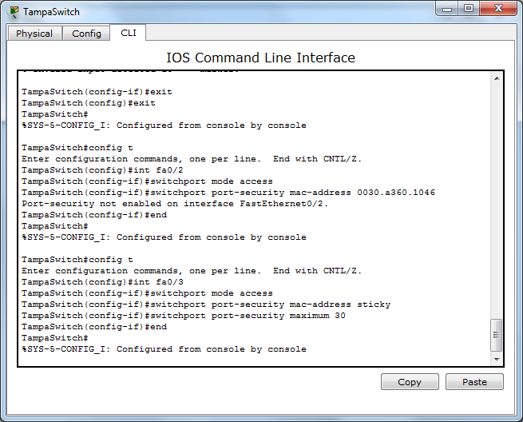

Slide 63
Chapter 8 – 1 VLAN’s

Slide 64
Clarify Terms
Network, subnet, LAN and VLAN are essentially the same thing.
Each one has a unique IP network address space.
Ex: 192.168.10.0/24

Slide 65
VLAN’s
Create a virtual LAN across many physical LANs.
Permits organizational and security flexibility
Limits Broadcast Domains
Must be matched with a subnet
Cannot do Inter-VLAN routing without a router or layer-3 switch

Slide 67
VLAN numbers
• VLAN 1: default Ethernet LAN, all ports start in this
VLAN.
• VLANs 1002 – 1005 automatically created for Token
Ring and FDDI
• Numbers 2 to 1001 can be used for new VLANs
• Up to 255 VLANs on Catalyst 2960 switch
• Extended range 1006 – 4094 possible but fewer
features

Slide 68
Port based
• Each switch port intended for an end device is
configured to belong to a VLAN.
• Any device connecting to that port belongs to
the port􀁠s VLAN.
• There are other ways of assigning VLANs but
this is now the normal way.
• Ports that link switches can be configured to
carry traffic for all VLANs (trunking)
Types of VLAN
• Data or user VLAN
• Voice VLAN
• Management VLAN
• Native VLAN
• Default VLAN

Slide 69
Data VLAN
• Carry files, e-mails, shared application traffic,
most user traffic.
• Separate VLAN for each group of users.
Voice VLAN
• Use with IP phone.
• Phone acts as a switch too.
• Voice traffic is tagged, given priority.
• Data not tagged, no priority.
Management VLAN
• Has the switch IP address.
• Used for telnet/SSH or web access for
management purposes.
• Better not to use VLAN 1 for security reasons.

Slide 70
Native VLAN
• For backward compatibility with older systems.
• Relevant to trunk ports.
• Trunk ports carry traffic from multiple VLANs.
• VLAN is identified by a 􀁬tag􀁺 in the frame.
• Native VLAN does not have a tag.
Default VLAN
• VLAN 1 on Cisco switches.
• Carries CDP and STP (spanning tree protocol)
traffic.
• Initially all ports are in this VLAN.
• Do not use it for data, voice or management
traffic for security reasons.

Slide 71
Static VLAN (Port-centric)
• If VLAN 20 did not exist before – then it does
now.
We are configuring an access port on a switch to belong to VLAN 20.

Slide 72
LAN Switching and Wireless – Chapter 2 23
Voice VLAN
• Configured for voice VLAN and data VLAN.

Slide 73
Traffic between VLANs
• Layer 2 switch keeps VLANs separate.
• Router can route between VLANs. It needs to
provide a default gateway for each VLAN as
VLANs are separate subnets.
• Layer 3 switch has a switch virtual interface
(SVI) configured for each VLAN. These act like
router interfaces to route between VLANs.

Slide 74
Trunking: 802.1Q
A trunk is a link between a switch and another switch or a router.
Trunks can carry traffic for multiple VLANs at one time.
IEEE 802.1Q trunking protocol
All trunks carry native VLAN traffic which is traffic not tagged as belonging to a VLAN
Default native VLAN is VLAN 1

Slide 75
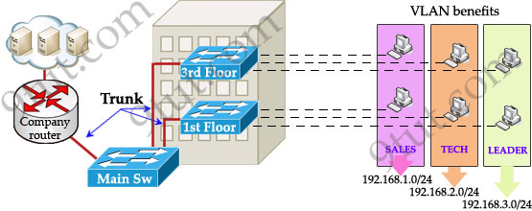

Slide 76
Trunking
• A trunk is a point-to-point link between one or more
Ethernet switch interfaces and another networking device,
such as a router or a switch.
• Ethernet trunks carry the traffic of multiple VLANs over a
single link.
• A VLAN trunk allows you to extend the VLANs across an
entire network.
• A trunk does not belong to a specific VLAN, rather it is a
• A trunk does not belong to a specific VLAN, rather it is a
conduit for

Slide 77
Tag to identify VLAN
• Tag is added to the frame when it goes on to the
trunk
• Tag is removed when it leaves the trunk

Slide 78
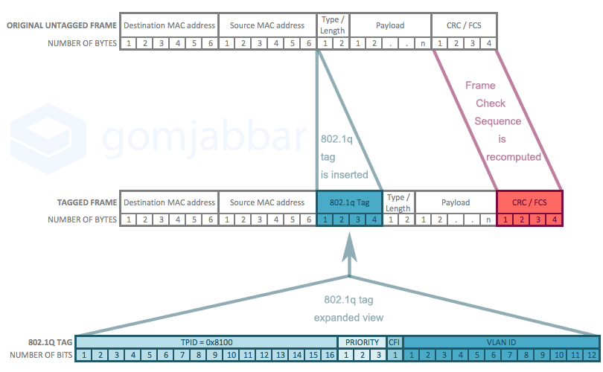
Tagged 802.1Q Ethernet Frame (Max frame size is 1522 Bytes, Min 68 bytes)
Identifies frame as a tagged 802.1Q frame
Sets priority of Frame (VLAN)
MAC address in canonical format?
VLAN ID

Slide 79
Priority Codes from Priority Field
PCP | Priority | Acronym | Traffic Types
1 | 0 (lowest) | BK | Background
0 | 1 | BE | Best Effort
2 | 2 | EE | Excellent Effort
3 | 3 | CA | Critical Applications
4 | 4 | VI | Video, < 100 ms latency and jitter
5 | 5 | VO | Voice, < 10 ms latency and jitter
6 | 6 | IC | Internetwork Control
7 | 7 (highest) | NC | Network Control

Slide 80
Configuring VLANs on Switches
Configure ports for access.
Configure ports for trunks.

Slide 81
Create a VLAN
• SW1(config)#vlan 20
• SW1(config-vlan)#name Finance
• SW1(config-vlan)#end
• VLAN will be saved in VLAN database rather
than running config.
• If you do not give it a name then it will be called
vlan0020.
Create Data VLAN
Assign port to VLAN
• SW1(config)#int fa 0/14
• SW1(config-if)#switchport mode access
• SW1(config-if)#switchport access vlan 20
• SW1(config-if)#end
Access port for end device

Slide 82
Remove port from VLAN
• SW1(config)#int fa 0/14
• SW1(config-if)#no switchport access vlan
• SW1(config-if)#end
• The port goes back to VLAN 1.
• If you assign a port to a new VLAN, it is
automatically removed from its existing VLAN.
Delete a VLAN
• SW1(config)#no vlan 20
• SW1(config)#end
• VLAN 20 is deleted.
• Any ports still on VLAN 20 will be inactive – not
on any VLAN. They need to be reassigned.

Slide 83
Delete VLAN database
• Erasing the startup configuration does not get
rid of VLANs because they are saved in a
separate file.
• SW1#delete flash:vlan.dat
• Switch goes back to the default with all ports in
VLAN 1.
• You cannot delete VLAN 1.

Slide 84
Configure trunk
• SW1(config)#int fa0/1
• SW1(config-if)#switchport mode trunk
• SW1(config-if)#switchport trunk native vlan 99
• SW1(config-if)#switchport trunk allowed vlan
add 10, 20, 30
• SW1(config-if)#end
Trunk problems
• Both ends must have the same native VLAN.
• Both ends must be configured with trunking on
or so that trunking is negotiated with the other
end and comes on.
• Subnetting and addressing must be right.
• The right VLANs must be allowed on the trunk.

Slide 85
Show Commands
Show commands
• show vlan brief (list of VLANs and ports)
• show vlan summary
• show interfaces vlan (up/down, traffic etc)
• Show interfaces fa0/14 switchport (access
mode, trunking)

Slide 87
Chapter 8 – 2 VTP

Slide 88
VTP
Small networks are manageable with regard to configuring each switch.
Large networks need centralized configuration for efficiency and security.

Slide 89
What is VTP?
• The VLAN Trunking Protocol – A Cisco proprietary
protocol which:
– Allows a network manager to configure a switch so that it will
propagate VLAN configuration to other switches in the network.
• Any switch can be configured a VTP server or VTP client.
• VTP only learns about normal-range VLANs (VLAN IDs 1 to
1005). Extended-range VLANs (IDs greater than 1005) are
not supported by VTP.
• VTP Overview
– VTP allows a network manager to makes changes on a switch
that is configured as a VTP server.
• The VTP server distributes and synchronizes VLAN
information to VTP-enabled switches throughout the switched
network, which minimizes the configuration inconsistencies.

Slide 90
VTP Domains
• A group of layer 2 switches sharing VLAN data
forms a VTP Domain.
• Ends at router or layer 3 switch.
• Switch can be linked by trunks, but not part of
domain.
• Each switch can belong to only one domain.
• Domain is defined by its name.
• Proprietary to Cisco, so all switches in domain
must be Cisco switches.

Slide 91
VTP modes
• Server – default mode. Sends VLAN
information to other switches.
• Client – receives VLAN information and
forwards it to other switches.
• Transparent – forward VTP traffic but do not
originate or use it. They can have their own
VLANs, not shared with other switches.
VTP Client
• Client receives VLAN information from server.
• Client switches then have the same VLANs as
the server.
• Client does not save VLAN information. It is
held only in RAM and lost if switch is powered
off.
• You can not change the VLAN configuration on
a VTP client.
– It must be changed on the VTP server and updated
via VTP.
VTP Server
• At least one switch acts as server.
• Create VLANs on this switch.
• Information saved in vlan.dat.
• Server sends VLAN information to client
switches over active trunk links.
• Add, delete, rename VLANs on server.
• Default mode of switch is server.

Slide 92
VTP Defaults
• Version 1. (Versions 2 and 3 also exist.)
• VTP domain name is not set.
• VTP mode server
• One active VLAN, VLAN 1
• Configuration revision number 0
• Any switches added to a domain should be in
the default condition or they may send
unwanted information to other switches.

Slide 93
VTP Features
• VTP Pruning - VTP pruning
increases available network
bandwidth by restricting
flooded traffic to those trunk
links that the traffic must use to
reach the destination devices.
• Without VTP pruning, a switch floods
broadcast, multicast, and unknown unicast
traffic across all trunk links within a VTP
domain even though receiving switches
might discard them.
VTP Pruning
• Disabled by default
• Enable it on one server in domain.
• Stops VLAN traffic from being sent on links
that do not lead to devices on that VLAN.
• Cuts down on traffic on trunk links.

Slide 95
Commands on VTP Server
• SW1(config)#vtp domain cisco1
• SW1(config)#vtp password cisco
– (Password is optional)
• Server mode is default, but if it was changed:
– SW1(config)#vtp mode server
• Version 1 is default, but command is:
– SW1(config)#vtp version 1
Commands on VTP Server
• Create VLANs
• Check that link is a trunk.
• Check VTP operation
– SW1# show vtp status
• Assign switch ports to VLANs.

Slide 96
Client configuration
• SW2(config)#vtp mode client
• Check that link is a trunk.
• Check VTP operation
– SW2# show vtp status
• Assign switch ports to VLANs.
Show vtp status
• VTP Version
• Maximum VLANs Supported
• Number of Existing VLANs
• VTP Operating Mode- server, client, or
transparent.
• VTP Domain Name
• VTP Pruning Mode
• VTP V2 Mode (disabled by default)
• VTP Traps Generation
• MD5 Digest (checksum of VTP configuration)
• Configuration Last Modified

Slide 97
Troubleshooting
• VTP Version. It needs to be the same on all
switches in the domain.
• Domain name. Is it exactly the same on all
switches?
• VTP Password if any. Is it exactly the same on all
switches?
• Check that there is at least one server. Better to
have at least two.
• If you recently added a new switch, had its revision
number been set to 0?

Slide 99
Chapter 8 – 3 Inter-VLAN Routing

Slide 100
Overview
End points on a VLAN can only communicate with end points on the same VLAN unless a layer 3 switch or router is used to connect to end points on other VLANs
Routers
Connect each switch to a separate router interface
Connect a switch to a single router interface (Router on a Stick)

Slide 101
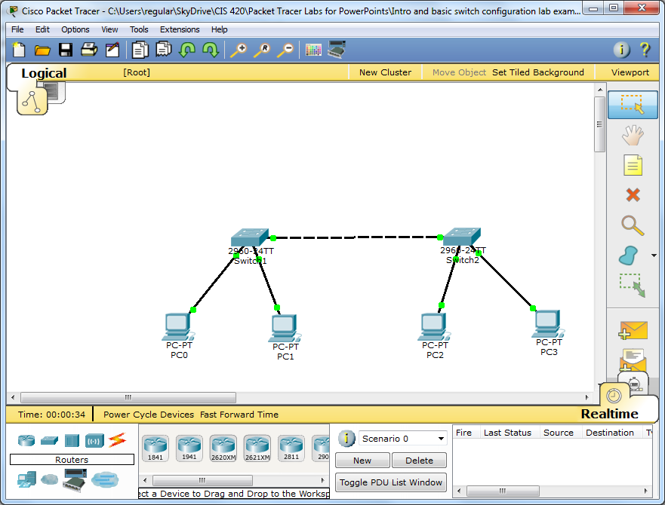

Slide 102
Inter VLAN Routing
Using two router interfaces
Assign an ip address from the subnet of each VLAN to each interface
In our lab, interface fa0/0 will get 192.168.10.254 (255.255.255.0)
In our lab, interface fa1/0 will get 192.168.20.254 (255.255.255.0)
On the switch connected to the router
Port fa0/3 will be placed into VLAN 10
Port fa0/4 will be placed into VLAN 20
Router fa0/0 will connect to SW1’s fa0/3
Router fa1/0 will connect to SW1’s fa0/4
Each PC will need to have its default gateway set to the appropriate IP address of the router
PC0 and PC2 will have a default gateway of 192.168.10.254
PC1 and PC3 will have a default gateway of 192.168.20.254

Slide 103
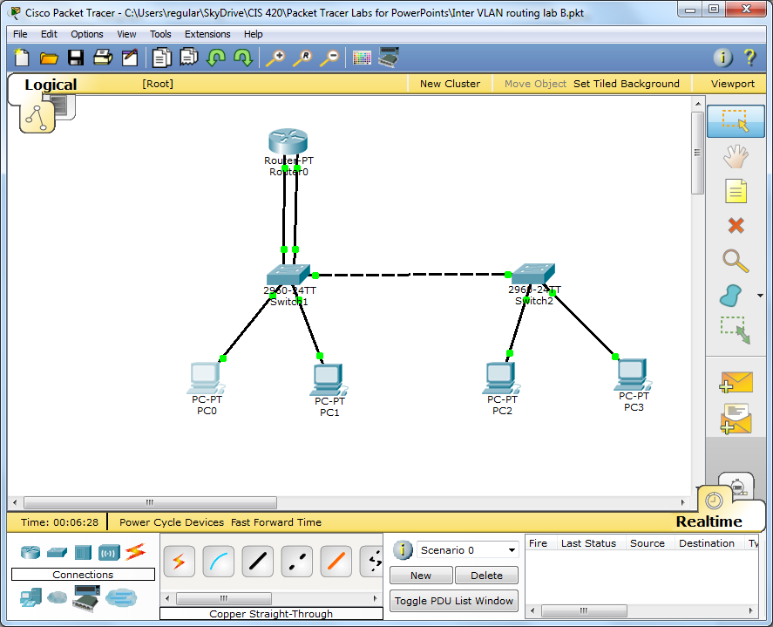

Slide 104
Inter VLAN Routing: Router-on-a-stick
Only one wire between router and switch
Router configured with subinterfaces
Fa0/0.10 for VLAN 10 at 192.168.10.254
Fa0/0.20 for VLAN 20 at 192.168.20.254
Switch’s port configured as trunk
Fa0/3 configured as switchport mode trunk

Slide 105
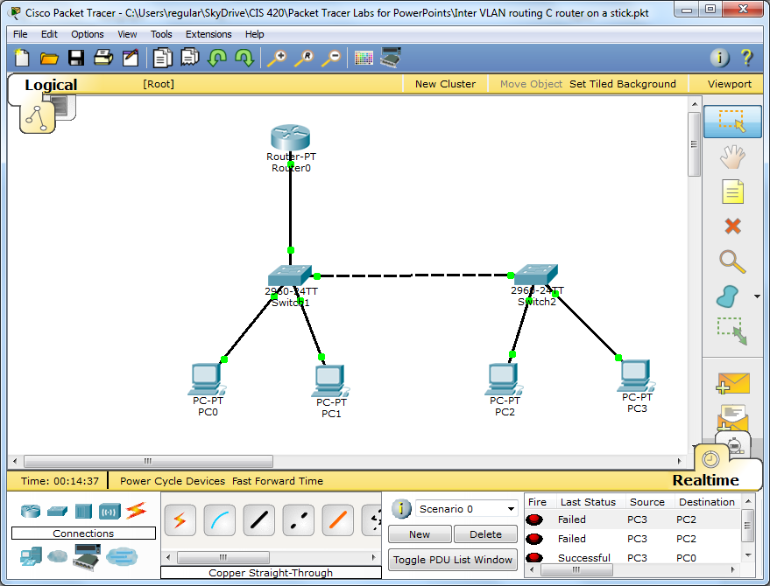

Slide 107
STP & Switch MAC Tables

Slide 108
We want:
• Redundancy at the
distribution and core
layers
• Multiple switches and
trunk links
• One link or device fails –
another takes over.

Slide 109
But redundancy gives loops
• Switching loops give problems if all the links
are active:
• Broadcast storms
• Multiple frame transmission
• Inconsistent switch tables
• Ethernet does not have a TTL like IP does,
so frames can bounce around a switched
network forever!

Slide 110
Broadcast storm
Flood broadcast
through nonsource
ports
Multiple Frame Transmissions
Send
ARP
request
Inconsistent switch tables

Slide 111
Redundancy without loops
• There needs to be just one path at a time.
• Redundant paths must be shut down, but
ready to be opened when they are needed.
• This must be done quickly and automatically.
• Spanning Tree Protocol does this.

Slide 112
MAC Table:
2A: Fa0/2
S1
Fa0/1
Fa0/2
Fa0/3
S2
S3
Fa0/1
Fa0/1
MAC Table:
2A: Fa0/1
MAC Table:
2A: Fa0/4
Fa0/4
Fa0/6
Arp Frame:
Whois 4B?
MAC: 2A
MAC: 4B

Slide 113
MAC Table:
2A: Fa0/2
4B: Fa0/3
S1
Fa0/1
Fa0/2
Fa0/3
S2
S3
Fa0/1
Fa0/1
MAC Table:
2A: Fa0/1
4B: Fa0/6
MAC Table:
2A: Fa0/4
4B: Fa0/1
Fa0/4
Fa0/6
Arp reply:
I am 4B
MAC: 2A
MAC: 4B

Slide 114
Switch Reminders
Switches begin with no MAC address table entries.
When a switch receives a frame whose destination MAC address is not in its MAC table (as in the beginning state when switches have no MAC entries), it floods copies of the frame out of every active port except the port from which the frame entered the switch.
It records the source MAC address from the frame that it received in its MAC address table as associated with the switches’ port number.

Slide 115
MAC Table:
2A: Fa0/2
S1
Fa0/1
Fa0/2
Fa0/3
S2
S3
Fa0/1
Fa0/1
MAC Table:
2A: Fa0/1
MAC Table:
2A: Fa0/4
Fa0/4
Fa0/6
Arp Frame:
Whois 4B?
Arp Frame:
Whois 4B?
MAC: 2A
MAC: 4B

Slide 116
Spanning tree protocol
• Used by switches to turn a redundant topology
into a spanning tree
• Disables unwanted links by blocking ports
• STP defined by IEEE 802.1d
• Rapid STP defined by IEEE 802.1w
• Switches run STP by default – no configuration
needed.

Slide 117
STP Algorithm
• STP uses the Spanning Tree Algorithm (STA) to
determine which switch ports on a network need to be
configured for blocking to prevent loops from occurring.
• STA designates a single switch as the root bridge and
uses it as the reference point for all calculations.
• When STA has determined which paths are to be left
available, it configures the ports into distinct port roles.
– Root ports - Switch ports closest to the root bridge.
– Designated ports - All non-root ports that are still permitted to
forward traffic on the network.
– Non-designated ports - All ports configured to be in a blocking
state to prevent loops.

Slide 118
Root Bridge
Designated Port
Designated Port
Root Ports
Designated Ports
Blocked State

Slide 119
1 Choose the root bridge
• Each switch has a bridge ID (BID) of priority
value followed by MAC address
• Switches exchange Bridge Protocol Data Units
(BPDUs) to compare bridge IDs
– BPDU data encapsulated in mulitcast Ethernet
Frames
• The switch with the lowest bridge ID becomes
the root bridge
• Administrator can set the priority to fix the
selection

Slide 120
Bridge ID
• The bridge ID consists of bridge priority,
extended system ID, and MAC address
• By default the priority is 32768
• Lowest priority wins
• Value 1 - 65536, multiples of 4096
• Extended system ID identifies VLAN.
• MAC address used if priority is the same.
Better not to rely on MAC address.

Slide 121
Configure priority
• Set priority directly
• SW1#spanning-tree vlan 1 priority 24576
• Or indirectly
• SW1#spanning-tree vlan 1 root primary
• Sets value to 24576 or 4096 less than lowest
priority detected.
• SW1#spanning-tree vlan 1 root secondary
• Sets value to 28672. This switch should becomes
the root bridge if the primary root bridge fails.

Slide 122
1 Choose the root bridge
• A switch starts up. It sends out BPDU frames
containing the switch BID and the root ID every 2
seconds.
• At first each switch identifies itself as the root bridge.
• If a switch receives a BPDU with a lower BID then it
identifies the switch with that BID as root bridge. It
passes on this information in its own BPDUs.
• Eventually all switches agree that the switch with the
lowest BID is the root bridge.

Slide 123
2 Select root ports
• Every non-root bridge (Switch) selects a root port
• This is the port with the lowest cost path to the root
bridge

Slide 124
Finding the cost of a link
• Default port costs depend on the speed of the
link. Set by IEEE.
• Costs may change as faster Ethernet is
developed.
Link speed | Revised Cost | Previous Cost
10 Gbps | 2 | 1
1 Gbps | 4 | 1
100 Mbps | 19 | 10
10 Mbps | 100 | 100

Slide 125
Changing the cost of a link
• SW1(config)#int fa0/1
• SW1(config-if)#spanning-tree cost 25
• SW1(config-if)#end
• SW1(config)#int fa0/1
• SW1(config-if)#no spanning-tree cost
• SW1(config-if)#end

Slide 126
LAN Switching and Wireless – Chapter 5 26
What if ports have the same cost?
• Use the port priority and port number.
• By default
F0/1 has128.1
F0/2 has128.2

Slide 127
Configure port priority
• SW2(config-if)#spanning-tree port-priority 112
• Priority values range from 0 - 240, in increments of
16.
• The default port priority value is 128.
• Lower port priority value wins.
• Default port priority is 128.
• Losing port is shut down.

Slide 128
Passing cost information
• Each BPDU includes the cost of the path back
to the root bridge.
• The cost is the total cost of all the links.
• As a switch receives a BPDU, it updates the
cost by adding on the cost of the port through
which the BPDU was received.

Slide 129
Port States
1. Blocking - The port is a non-designated port and does not participate in frame
forwarding.
– The port receives BPDU frames to determine the location and root ID of the root
bridge switch and what port roles each switch port should assume in the final active
STP topology.
2. Listening - STP has determined that the port can participate in frame
forwarding according to the BPDU frames that the switch has received thus
far.
– At this point, the switch port is not only receiving BPDU frames, it is also
transmitting its own BPDU frames and informing adjacent switches that the switch
port is preparing to participate in the active topology.
3. Learning - The port prepares to participate in frame forwarding and begins to
populate the MAC address table.
4. Forwarding - The port is considered part of the active topology and forwards
frames and also sends and receives BPDU frames.
5. Disabled - The Layer 2 port does not participate in STP and does not forward
frames.
– The disabled state is set when the switch port is administratively disabled.

Slide 130
Cisco PortFast
• An access port leading to a workstation or
server does not need to go through the STP
modes because it will not be closed down.
• PortFast allows the port to go directly from
blocking to forwarding.
• If a switch is connected later and the port
receives a BPDU then can go to blocking and
then through the modes. (BPDUGuard)

Slide 132
LAN Switching and Wireless – Chapter 5 37
Topology change notification
(TCN)
• After the network converges, the root bridge sends
out BPDUs, but the other switches do not normally
send BPDUs back.
• If there is a topology change, a switch sends a
special BPDU called the topology change
notification (TCN) towards the root bridge.
• Each switch that receives the TCN sends an
acknowledgement and sends a TCN towards the
root bridge until the root bridge receives it.
• The root bridge then sends out BPDUs with the
topology change (TC) bit set.

Slide 133
LAN Switching and Wireless – Chapter 5 37
Topology change notification
(TCN)
• After the network converges, the root bridge sends
out BPDUs, but the other switches do not normally
send BPDUs back.
• If there is a topology change, a switch sends a
special BPDU called the topology change
notification (TCN) towards the root bridge.
• Each switch that receives the TCN sends an
acknowledgement and sends a TCN towards the
root bridge until the root bridge receives it.
• The root bridge then sends out BPDUs with the
topology change (TC) bit set.

Slide 134
PVST+
• PVST+ is the default spanning-tree
configuration for recent Catalyst switches.
• The VLAN needs to be identified, so each BID
has 3 fields: priority, extended system ID field,
containing VLAN ID, MAC address.
• Original BID just had priority, MAC address

Slide 135
What is RSTP?
• RSTP (IEEE 802.1w) is an evolution of the 802.1D.
– RSTP does not have a blocking port state.
• RSTP defines port states as discarding, learning, or
forwarding.
• Port F0/3 on switch S2 is an alternate port in discarding
state.
• RSTP can achieve much faster convergence in a
properly configured network, sometimes in as little as a
few hundred milliseconds.
– If a port is configured to be an alternate or a backup port
it can immediately change to a forwarding state without
waiting for the network to converge.

Slide 136
• The following briefly describes RSTP characteristics:
– RSTP is the preferred protocol for preventing Layer 2
loops in a switched network environment.
– Cisco-proprietary enhancements, such as UplinkFast
and BackboneFast, are not compatible with RSTP.
– RSTP (802.1w) supersedes STP (802.1D) while
retaining backward compatibility.
• In addition, 802.1w is capable of reverting back to 802.1D to
interoperate with legacy switches on a per-port basis.
– RSTP keeps the same BPDU format as IEEE 802.1D,
except that the version field is set to 2 to indicate RSTP.
– Port can safely transition to the forwarding state without
having to rely on any timer configuration.

Slide 137
Design considerations
• Root bridge should be a powerful switch in the
centre of the network.
AND – configure root bridge manually!!!
• Minimise the number of ports that need to be
shut down by STP.
• Use VTP pruning.
• Use layer 3 switches in the core.
• Keep STP running even if no ports need to be
shut down.

Slide 138
Shortest Bridge Path
Newer switching technology that is part of Software Defined Networking or SDN
IEEE 802.aq standard
Permits active redundant links for more efficient switching at layer 2
Algorithm based upon link-state routing protocol IS-IS (Layer 3)
Cisco has a competing technology called FabricPath which is based upon the IETF’s Trill (transparent inter-connection of lots of links)

Slide 140
Basic Router Configuration

Slide 141
Basic Configuration
Host Name
Passwords for console, executive privilege and VTY
MOTD Banner (must be careful with this)
Interfaces
Show Commands for verification of settings

Slide 142
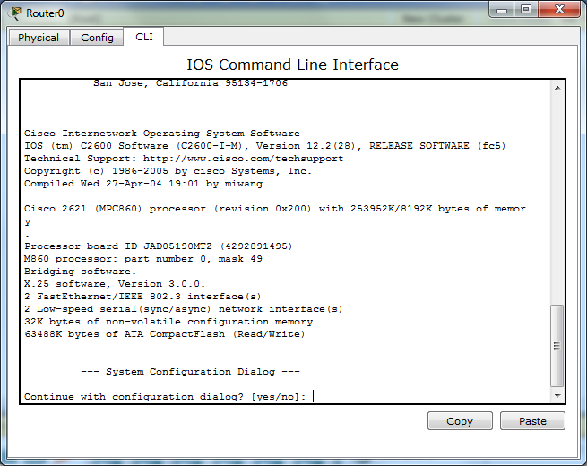
Remember to always answer ‘no’ to the auto configuration question.

Slide 143
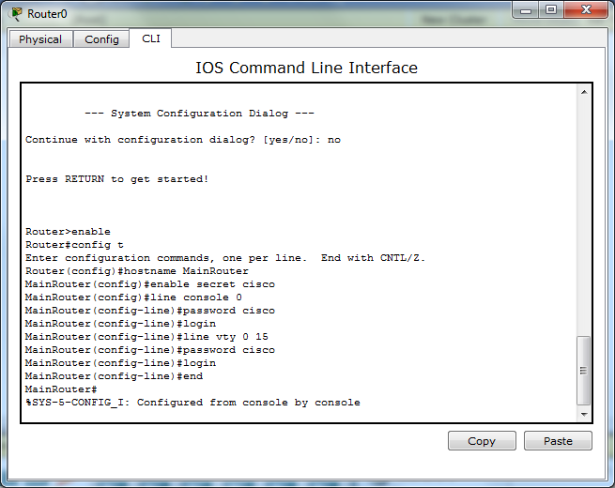
Enter exec mode and configure new hostname and passwords for exec mode, console access and VTY lines.

Slide 144
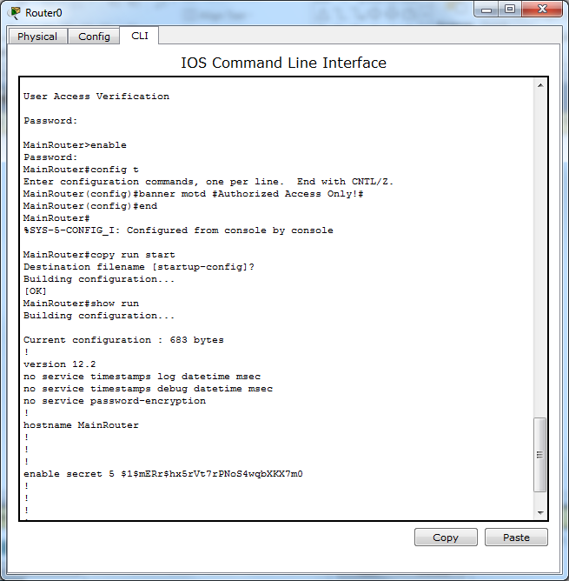
Configure banner MOTD (message of the day). This appears when someone logs onto the console port. It should specify that access is restricted. Next, we copy run to start to copy the running configuration file to the startup configuration file to save our changes to the router.

Slide 145
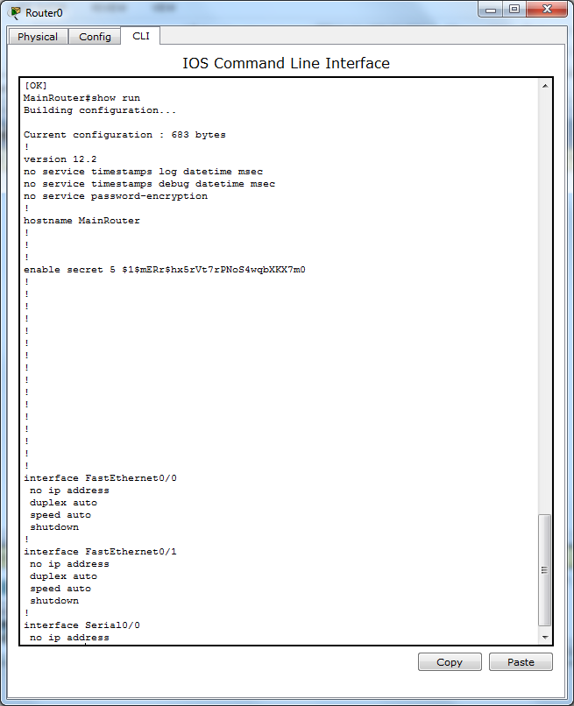
Partial display of the output from the show run command.

Slide 146
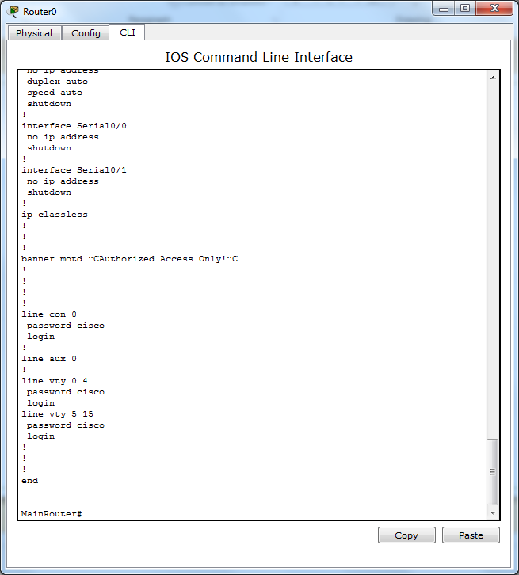
Display of the remainder of the output from the show run command.

Slide 147
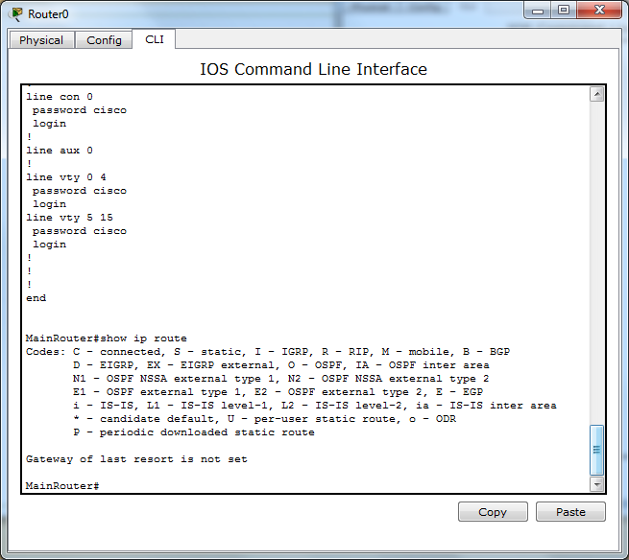
Output from the show ip route command. There are no connections to any other devices from this router, so there are no routes displayed. This show command will be used extensively when we begin to configure interfaces on our routers and configure routes.

Slide 148
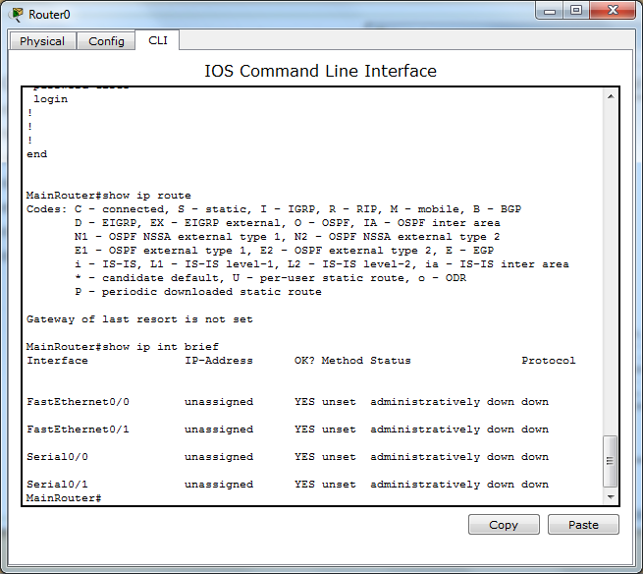
The show ip interfaces brief command displays the status of interfaces of the router in abbreviated form.

Slide 149
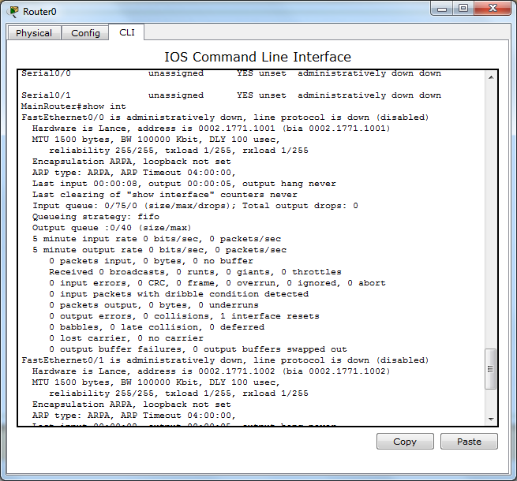
The show interfaces command displays detailed information about each interface just as it does with switches.

Slide 150
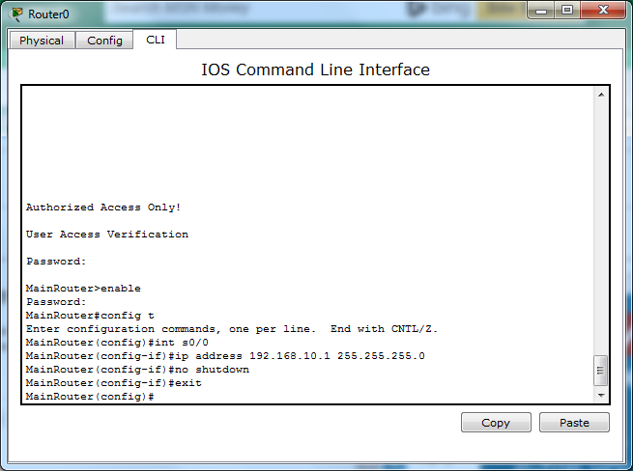
Configuring interfaces is the first step of connecting routers to other routers and switches. Each router interface is the edge of a particular network which means that for a given interface, an IP address is assigned within that network. Interfaces that are connected to other devices and have an IP address configured are classified as ‘direct connections.’

Slide 151
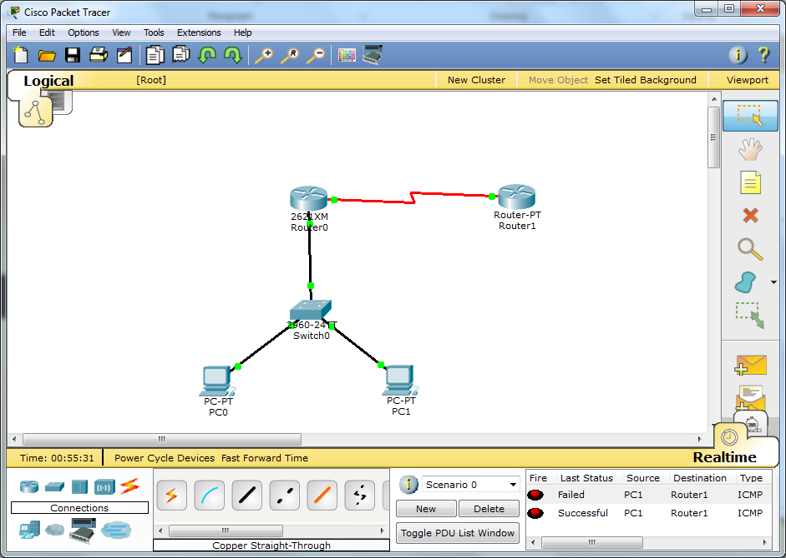
192.168.10.0/24 network
192.168.20.0/24 network

Slide 152
Summary
Routers have a set of basic configurations for administrative and security reasons
Routers have a set of ‘show’ commands that display the status of configuration files, ip routes and interfaces.
Interfaces are connected to other devices and are assigned IP addresses within that network associated with that interface.

Slide 154
Routers and Routing Protocols

Slide 155
Routers are Computers
CPU
Motherboard
RAM: running IOS, Running configuration file, IP Routing Table, ARP cache, Packet buffering.
ROM: Boot code, POST/diagnostic code, basic IOS
Flash Memory: IOS storage
NVRAM: startup configuration file
Ports for Network media called interfaces.
Ethernet
Serial
Administrative ports
Console port – connect configuration computer via serial port or USB port
Auxiliary port – for dial-up telnet connections

Slide 156



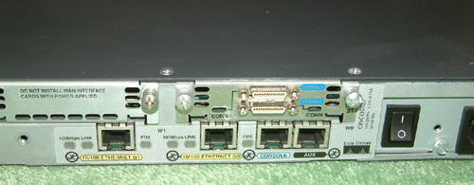
Cisco 2621 Router with W1C2T Serial Board installed
Serial Ports (WAN/Router connections)
Fast Ethernet Ports
Console Port
Aux Port

Slide 157
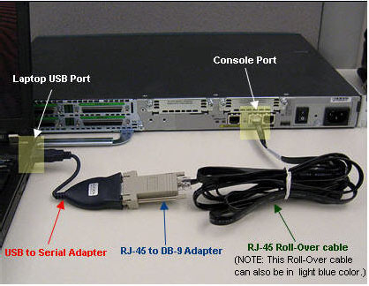

Slide 158
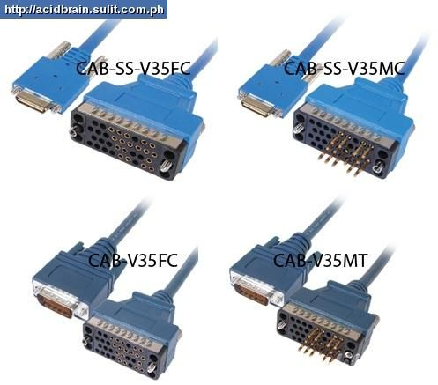
Serial Cables

Slide 159
Router Functions
Path Determination by routing table information
Directly connected routes
Static routes
Dynamic routes
Default routes
Metrics
Bandwidth
Delay
Hop Count
Cost (set by administrator)
Packet Forwarding

Slide 160
Dynamic Routing Protocols
Distance vector
Router knows the direction to send packet to a network (interface).
Router knows the distance to the destination network.
Periodic updates (RIP)
Link-state
Routers has topological map of entire network.
Usually triggered updates that prevent unnecessary traffic.

Slide 161
Routing Protocols
Distance Vector
RIP
IRGP
EIGRP ????
Link-State
OSPF
IS-IS
Path Vector
BGP

Slide 162
Packet Delivery Process
Routing packets from end host to end host requires the binding of MAC and IP addresses (Layer 2 & Layer 3 Addresses)
Packets (layer 3) are PDU’s delivered from one host to another.
Frames (layer 2) deliver packets within network segments/broadcast domains.
LANs: Ethernet frames
WANs: PPP or HDLC frames

Slide 163
Address Resolution Protocol
ARP binds IP and MAC addresses together within a broadcast domain.
Network hosts to include routers and end workstations build ARP tables that their OS’s uses to address packets and frames
For end hosts, this can be to another end host on the LAN or to the default gateway router.
For routers, it can be an end host on a connected LAN, another router within the AS or another router on a WAN link (usually a one-link connection; broadcast WAN frame used).

Slide 164
Building the ARP Table
An end host must learn the MAC addresses/ IP addresses of the other end hosts on its LAN.
It sends out ARP requests to build this table
Packets bound for end hosts outside of the LAN must go through the default gateway.

Slide 165
Network Utilities
Ping (w/ optional flags)
Tracert (w/ optional flags)
ARP (w/ optional flags)

Slide 167
Part 5
Static Routing

Slide 168
Router Activities
Identify destination address of packet
Identify sources of routing information
Identify routes
Select routes
Maintain and verify current routing information

Slide 169
Static Routing
Routes configured by administrator/engineer.
Do not change until manual reconfiguration or deletion by administrator/engineer.
Can permit precise routing behavior, but caution must be exercised in creating and maintaining static routes.

Slide 170

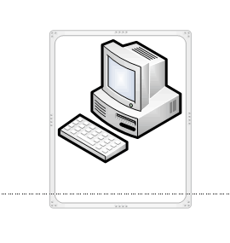
Some Points First.
C
Each router interface has an assigned IP address.
Each static IP route assignment has a destination of the interface number of the router or the IP address of the other router’s interface
Configure the static route to network 172.16.50.0/24 on router A.
B
192.168.50.254
Serial0/1
172.16.50.254
Serial0/2
192.168.50.252
Serial0/2
172.16.50.252
Serial0/1
A
192.168.10.254
Ethernet fa0/1

Slide 171
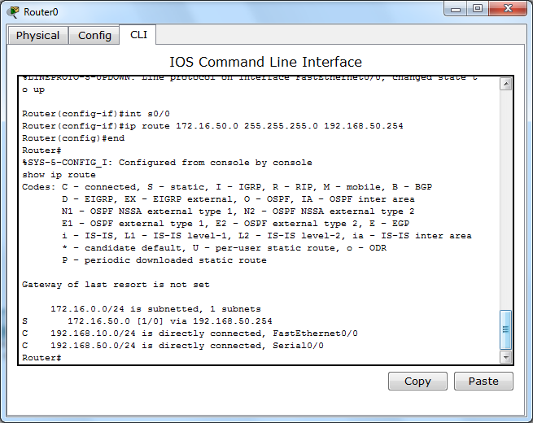
Configure route to 172.16.50.0 via next hop IP address of 192.168.50.254
C
B
192.168.50.252
Serial0/0
172.16.50.254
Serial0/2
192.168.50.254
Serial0/2
172.16.50.252
Serial0/1
A
192.168.10.254
Ethernet fa0/1

Slide 172
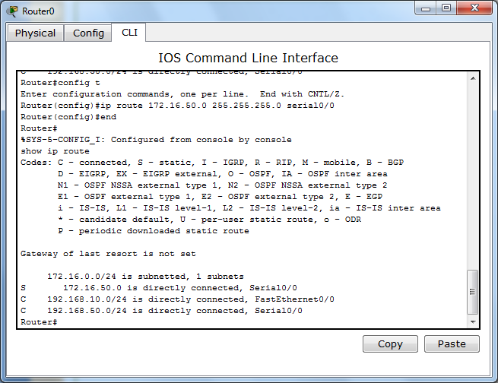
Configure Route to 172.16.50.0 via Serial Interface 0/0

Slide 173
When to Use Static Routes
On edge routers to forward traffic to ISP
If a default route is needed to forward packets
On a stub router (same logic as ISP edge)
Default static route to cover all possibilities:
Quad-zero route
0.0.0.0 0.0.0.0

Slide 174

Default All outbound
Default All outbound
S0/0
ATT
Stub router
Edge router to ISP
192.168.10.0/24

Slide 175
Configure Edge Router to ATT
Router(config)#ip route 0.0.0.0 0.0.0.0 s0/0

Slide 176
Trouble-Shooting
Look for obvious, simple problems first
Interface in shutdown mode
Incorrect IP addresses/interface assignments
Common Problems
Interface failures
Connection to ISP dropped
Link saturation
Incorrect configurations

Slide 177
Trouble-shooting Tools
Network utilities PING and Tracert
Show IP route and Show IP interfaces brief
Always remove an incorrect static route. Otherwise, they remain in the routing table.

Slide 179
OSPF Concepts

Slide 180
History
OSPF dates back to 1987
OSPFv2 (1998) is the current standard
OSPFv3 (1999) is for IPv6
OSPF developed by the Internet Engineering Task Force or IETF
ISO simultaneously developed IS-IS which is a competing IGRP to OSPF.
OSPF is a link-state Interior Gateway Protocol (IGP)
Each router has a topological map of the entire network area
Scalable, but should be developed in a hierarchical architecture.
OSPF networks are subdivided by ‘areas’.
Default metric is cumulative bandwidth of links between routers.

Slide 181
OSPF Messages
IP Packet Data Field
Data Link Header | IP Packet Header | OSPF Packet Header | OSPF Packet Type-Specific Data
Type Code for OSPF Packet Type Router ID and Area ID
0x01 Hello 0x02 Database Description 0x03 Link State Request 0x04 Link State Update 0x05 Link State Acknowledgement

Slide 182
OSPF Packets
Send information between OSPF routers using IP packets
Use IPv4 Multicast 224.0.0.5 and 224.0.0.6
IP packet protocol field is set to 89 to indicate OSPF packet.
If Ethernet frame is used, frame is set to multicast address 01-00-5E-00-00-05 or 01-00-5E-00-00-06.

Slide 183
Discovering Neighbors
OSPF routers check to see if any directly connected routers are also OSPF routers.
This is done by exchanging Hello packets with one another that include the Router ID.
If a router detects an OSPF neighbor, it will form an adjacency with that router.
Routers must agree upon hello interval, dead interval and network type

Slide 184
Hello and Dead Intervals
Hello packets are sent out every 10 seconds by default to inform neighboring routers that the router is still active (30 seconds on NBMA networks).
Dead intervals are set at 4 times the value of the Hello packet or 40 seconds in the default case. This is the time that a router waits after NOT receiving a Hello packet from a neighboring router before declaring it down.

Slide 185
Network Types
Point to Point – one link between two routers
Broadcast multiaccess – more than one router connected to a switch(s).
Nonbroadcast multiaccess – Frame Relay, ATM WAN links
Point to multipoint – WAN links
Virtual Links – special link that can be used in multi-area OSPF.

Slide 186
OSPF Packet Types
Hello
DBD – database synchronization info
LSR, Link State Request – requests specific link-state records from router to router
LSU, Link State Updates – Sends specifically requested link state records (LSA, link state advertisements – 11 subtypes)
LSAck, Link State Acknowledgements – acknowledgement sent for other packet types

Slide 187
LSU sub-types
LSA Type | Description
1 | Router LSA
2 | Network LSA
3 or 4 | Summary LSA
5 | Autonomous System External LSA’s
6 | Multi-cast OSPF LSA’s
7 | Defined for not-so-stubby areas
8 | External Attributes LSA for Border Gateway Protocol (BGP)
9, 10, 11 | Opaque LSA’s

Slide 188
Router ID
Determined in order of priority:
IP address configured with the router-id command
Highest IP address of any loopback interfaces
Highest active IP address of an interface
Loopback method is most common since it supports legacy routers and IOS’s.

Slide 189
We will use loopback for our router ID’s in our current example
R1(config)#interface loopback 0
R1(config)#ip address 10.1.1.1 255.255.255.255
R2(config)#interface loopback 0
R2(config)#ip address 10.2.2.2 255.255.255.255
R3(config)#interface loopback 0
R3(config)#ip address 10.3.3.3 255.255.255.255

Slide 190
Router-ID Command
Router(config)#router ospf 1
Router(config)#router-id 10.1.1.1
To Clear ID:
Router(config)#clear ip ospf process
OR use a loopback interface (ensures legacy compatibility)
Router(config)# interface loopback 1
Router(config-if)#ip address 10.1.1.1 255.255.255.255

Slide 191
Checking Out OSPF Settings
Show IP Protocols (displays router ID and networks)
Show IP OSPF (detailed OSPF parameters)
Show IP OSPF interface serial0/0/0 (for an interface)
Show IP OSPF neighbor (shows adjacencies)

Slide 193
OSPF Implementation

Slide 194
OSPF Metric
Based on Cumulative Bandwidth of links.
Formula: OSPF Cost = 10⁸ / bandwidth in bps
Each interface is calculated and cumulative cost determined.

Slide 195
Modifying Cost Reference Bandwidth
Change the 10⁸ base for bandwidth cost calculations
Expressed in Mbps with 100 being the default value.
To change if we are using Gigabit Ethernet on a link
Router(config-router)auto-cost reference-bandwidth 1000
Increases the cost numbers for each type of interface
T1 at cost of 64 becomes 10⁹ / 1,544,000 = 648

Slide 196
Modifying OSPF Link Costs
Only affects cost calculations, does not change speed of link.
Bandwidth bandwidth-kbps
Router(config-if)#bandwidth 64
IP OSPF cost cost (use in multivendor environments)
Router(config-if)#ip ospf cost 1562

Slide 197
Calculation Table
Interface Type | 10⁸ / bps = Cost
Fast Ethernet or Faster | 100,000,000/100,000,000 = 1
Ethernet (10Mbps) | 100,000,000/10,000,000 = 10
E1 | 100,000,000/2,048,000 = 48
T1 | 100,000,000/1,544,000 = 64
128 Kbps | 100,000,000/128,000 = 781
64 Kbps | 100,000,000/64,000 = 1562
56 Kbps | 100,000,000/56,000 = 1785
Reference bandwidth can be changed from 10⁸ using auto-cost reference-bandwidth command (for Gigabit Ethernet)

Slide 198
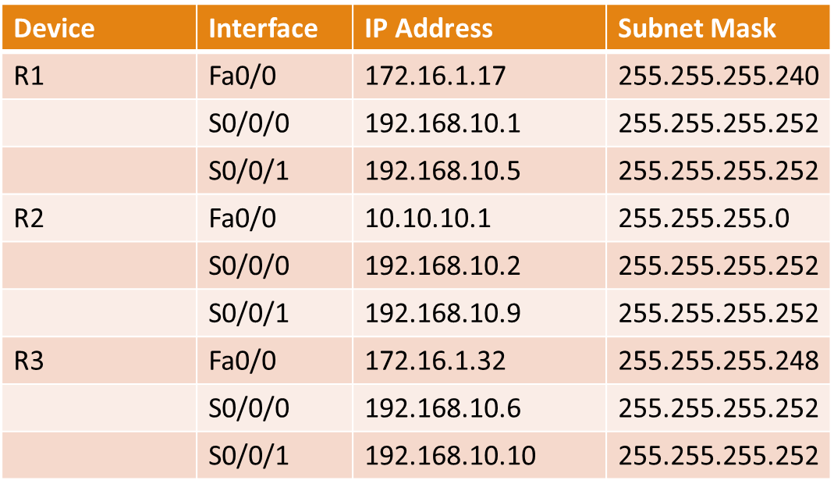
10.10.10.1/24
Fa0/0
S0/0/0
S0/0/1
DCE
R2
ID: 10.2.2.2
192.168.10.8/30
192.168.10.0/30
64 Kbps
128 Kbps
S0/0/0
DCE
S0/0/1
192.168.10.4/30
Fa0/0
256 Kbps
Fa0/0
S0/0/1
S0/0/0
DCE
172.16.1.16/28
R1
ID: 10.1.1.1
R3
ID: 10.3.3.3
172.16.1.32/29

Slide 199
Basic OSPF Configuration
OSPF command entered in configuration mode along with process id number.
Directly connected network’s will be entered along with their respective masks and area id.
Network masks are in the wildcard mask format.
Inverse of subnet masks
255.255.255.0 becomes 0.0.0.255

Slide 200
Getting Started with Configuration
R1(config)#router ospf 1
R1(config-router)#network 172.16.1.17 0.0.0.15 area 0
R1(config-router)#network 192.168.10.1 0.0.0.3 area 0
R1(config-router)#network 192.168.10.5 0.0.0.3 area 0
R2(config)#router ospf 1
R2(config-router)#network 10.10.10.0 0.0.0.255 area 0
R2(config-router)#network 192.168.10.2 0.0.0.3 area 0
R2(config-router)#network 192.168.10.9 0.0.0.3 area 0
R3(config)#router ospf 1
R3(config-router)#network 172.16.1.32 0.0.0.7 area 0
R3(config-router)#network 192.168.10.6 0.0.0.3 area 0
R3(config-router)#network 192.168.10.10 0.0.0.3 area 0

Slide 201
Configuring OSPF for Router 4 – Gateway Next Example
Router(config)#router ospf 1
Router(config-router)# network 172.16.30.0 0.0.0.255 area 0
Router(config-router)# network 10.10.10.0 0.0.0.255 area 0
Router(config-router)# default-information originate
Router(config-router)#end

Slide 202
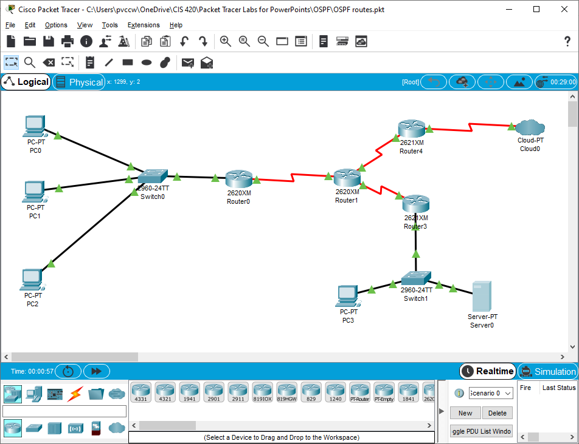
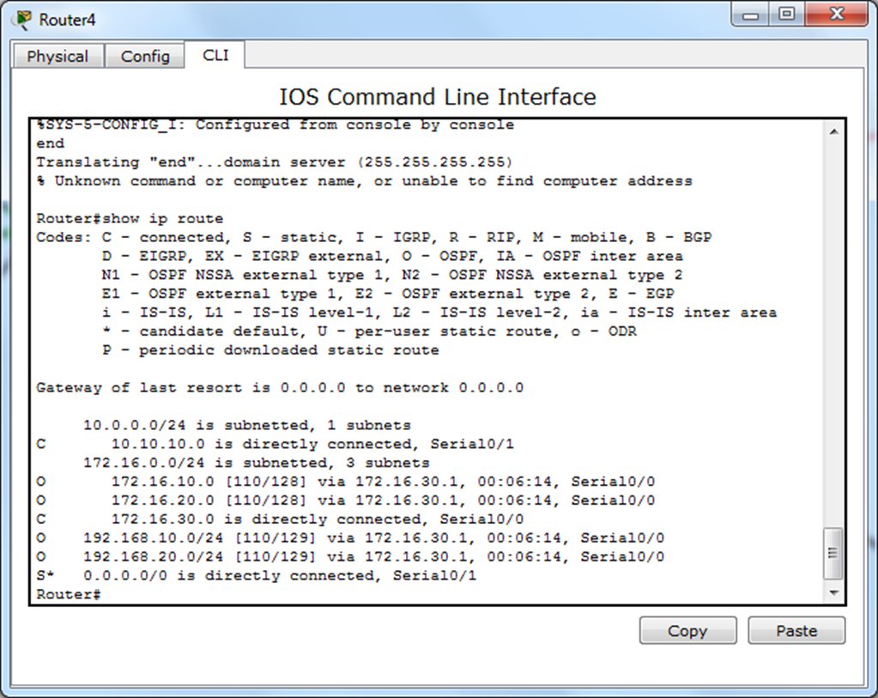
10.10.10.254
172.16.30.1

Slide 203
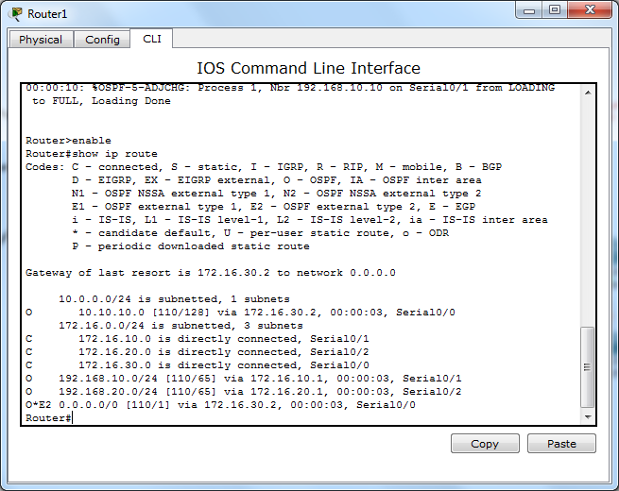

Slide 204
Redistributing an OSPF Default Route
Since one router in an area, an area border router (ABR), has the only route out of the area, it handles default traffic out of the network.
ABR has a default route of quad-zero or 0.0.0.0/0.
We can use the default-information originate command on the ABR to send this route information to all routers in the area.

Slide 206
OSPF DR and BDR

Slide 207
Network Types
Point to Point – one link between two routers
Broadcast multiaccess – more than one router connected to a switch(s).
Nonbroadcast multiaccess – Frame Relay, ATM WAN links
Point to multipoint – WAN links
Virtual Links – special link that can be used in multi-area OSPF.

Slide 208


Broadcast MultiAccess Networks

Slide 209

Multiple Adjacencies
For N routers, adjacencies = n(n-1)/2

Slide 210
Problems with Multiple Adjacencies
LSAs will be flooded from each router causing an overwhelming amount of traffic that will choke the network.
The solution is to elect one router per area to coordinate the distribution of update LSAs.
This router is the Designated Router or DR.
A second router is selected as the Backup Designated Router or BDR.
The DR and BDR are elected by the routers in the area.
Careful management must be exercised to configure the desired routers as DR and BDR.

Slide 211
LSAs only pass between DR/BDR and router sending update LSAs. The DR then multicasts the LSAs to all other routers.
DR
BDR
LSA
LSA
LSA
LSA

Slide 212
DR and BDR Election
Routers elect a DR and BDR upon start up of routers with active interfaces (including loopbacks)
Router with highest interface IP is elected DR and router with the next highest IP is elected BDR.
For an engineer to create the desired election results, interface priority and start up sequence has to be manipulated be it either router or interface.

Slide 213

BDR
Lo0 192.168.31.22/32
Fa0/0 192.168.1.2/24
Lo0 192.168.31.11/32
DR
Lo0 192.168.31.33/32
Fa0/0 192.168.1.1/24
Fa0/0 192.168.1.3/24

Slide 214
Setting Interface Priority – Force Election of DR and BDR
Router(config-if)#ip ospf priority 0-255 (higher number is higher priority)
This takes precedence over router ID, but it is still a good idea to have ‘default’ interface values that would force the same results during the DR election.
Ex:
Router(config)#int loopback 0
Router(config-if)#ip address 10.10.10.1 255.255.255.255
Router(config-if)#ip ospf priority 255

